Slide 1
Computer Graphics
Lecture 5
Illumination I – Local Models

Slide 2
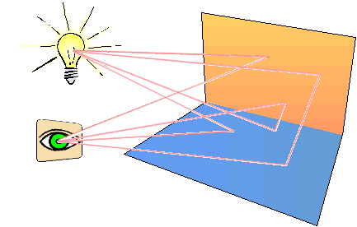
Illumination Models
Illumination: transport of luminous flux from light sources via direct & indirect paths.
Lighting: computing intensity reflected from 3D point in scene.
Shading: assigning pixel colour.
Illumination Models:
Empirical: simple approximations to observed phenomena.
Physically-based: model actual physics of light interactions.
Lecture 5

Slide 3
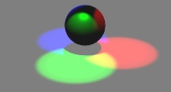
Two Components of Illumination
Light Sources: 光源
Emittance spectrum (colour)
Geometry (position and colour)
Directional attenuation
Surface Properties: 表面
Reflectance spectrum (colour)
Geometry (position, orientation, and micro-structure)
Absorption
Simplifications: 简化
Use only direct illumination from emitters to reflectors
Ignore geometry of emitters, use only geometry of reflectors
Lecture 5

Slide 4
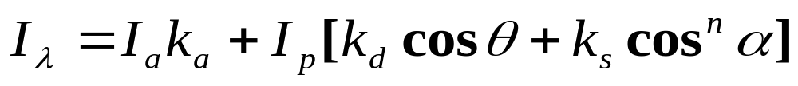
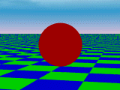
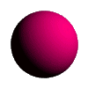
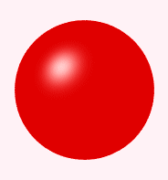
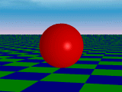
Illumination model from last lecture
Ambient
Diffuse
Specular
Lecture 5

Slide 5
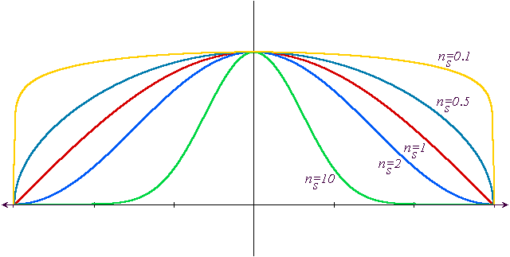
Phong model – the effect of n
n=0.1
n=0.5
n=1
n=2
n=10
Lecture 5

Slide 6
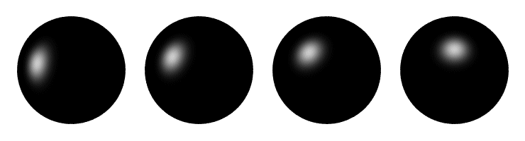
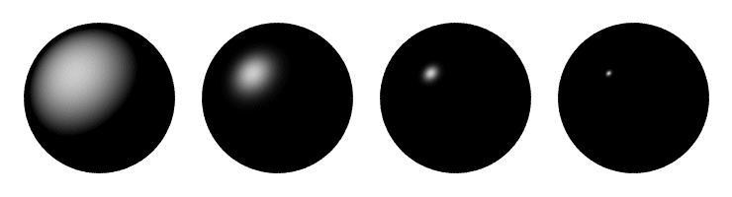
Phong examples
Lecture 5

Slide 7
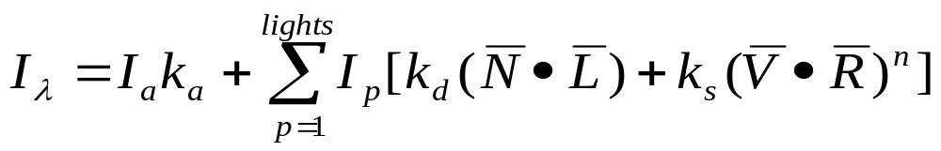
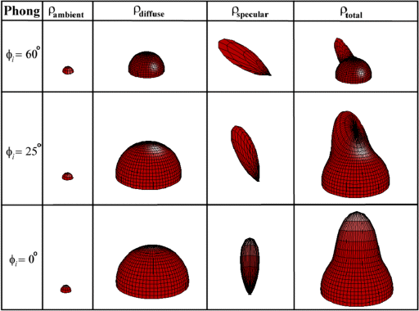
There may be a number of Point Sources
Extend empirical model as: (and replacing cosines)
This is known as the standard
LOCAL ILUMINATION MODEL
Lecture 5

Slide 8
Local Illumination Model
Considers light sources and surface properties only.
Approximations based on appearance.
Fast real-time interactive rendering.
Haven’t considered light attenuation – inverse square law – but don’t like exponentiation and doesn’t always look right.
Lecture 5

Slide 9
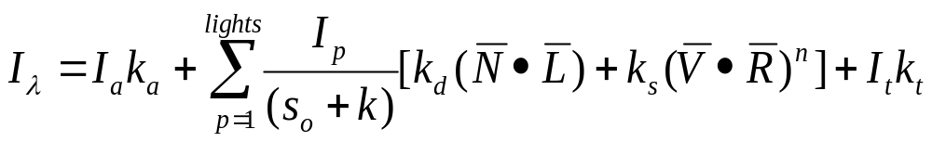
Local Illumination Model
Use 1/(s+k) where s relates to eye-object distance and k is some constant for scene.
Can add transparency too, to give final empirical model as shown below:
Lecture 5

Slide 10




Shading Polyhedra
Objects modelled as plane-faced polyhedra
Assumptions:
  Source at infinity constant.
  Viewer at infinity constant.
  Polygon is not an approximation – often incorrect and need smoother shading.
If first two unacceptable, average .
For specularity varies across surface.
Lecture 5

Slide 11
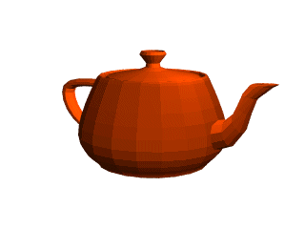
Shading Polyhedra
Flat (facet) shading:
  Works well for objects
  really made of flat faces.
  Appearance depends on
  number of polygons for
  curved surface objects.
If polyhedral model is an approximation then need to smooth.
Lecture 5

Slide 12
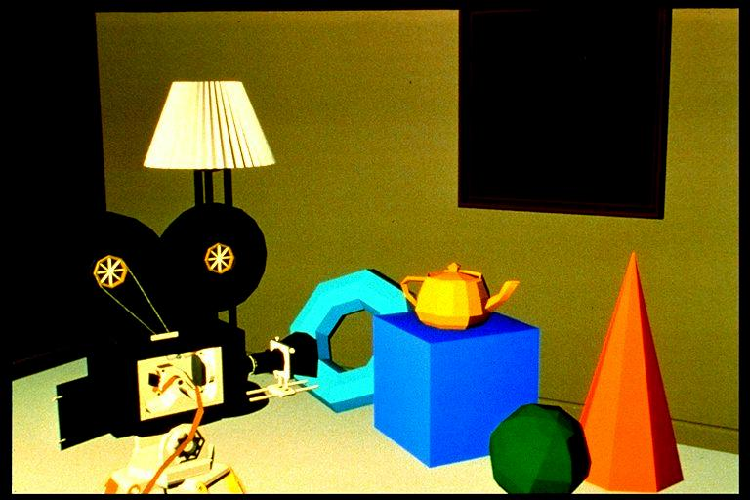
Mach banding.
Physiological effect exaggerates difference between closely coloured polygons.
Mach banding.
Exaggerates intensity change at an edge with a discontinuity in magnitude.
Our eyes are well adapted to seeing edges !
Using a finer mesh is surprisingly ineffective.
Lecture 5

Slide 13
Interpolated shading.
Wylie, Romney, Evans and Erdahl pioneered linear interpolation of shading information from the vertices.
Gouraud generalized this to arbitrary polygons.
Interpolate illumination in same manner as we interpolated z for z-buffering.
  Not physically correct for illumination.
Assumption of polygon approximating a curved surface gives rise to largest error.
Lecture 5

Slide 14



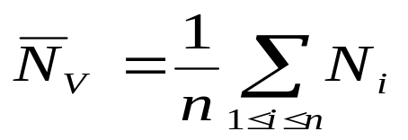


Gouraud Shading.
Find vertex normals by averaging face normals, or find analytically.
- Use vertex normals with desired shading model,
Interpolate vertex intensities along edges.
Interpolate edge values across a scanline.
B
A
I_{bc}
I_{ac}
I_{ac} interpolated A to C, I_{bc} interpolated B to C.
C
Lecture 5

Slide 15
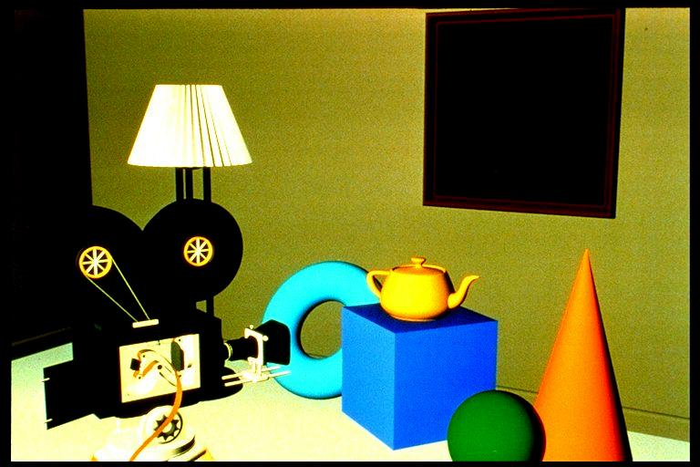
Gouraud shading
Lecture 5

Slide 16
Phong shading.
Normals are calculated for each vertex.
Vectors are interpolated across the face.
Illumination calculated with interpolated normal vector, ie. shading model applied each step.
Interpolated
normals.
Assume polygon is approximation to curved surface.
Lecture 5

Slide 17
Phong shading.
In Phong model of specular reflection, highlight falls off with cos^{n} α
Gouraud shading linear interpolates – makes highlight too big.
Gouraud shading may well miss a highlight that occurs in the middle of the face.
Direction of maximum highlight
Lecture 5

Slide 18
Phong shading.
In Phong model of specular reflection, highlight falls off with cos^{n} α
Gouraud shading linear interpolates – makes highlight too big.
Gouraud shading may well miss a highlight that occurs in the middle of the face.
Direction of maximum highlight
Highlight on surface.
Lecture 5

Slide 19
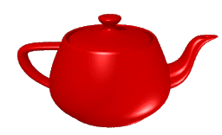
Phong example
Lecture 5

Slide 20
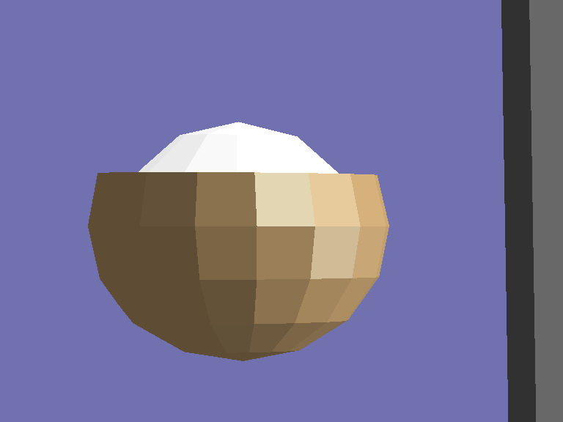
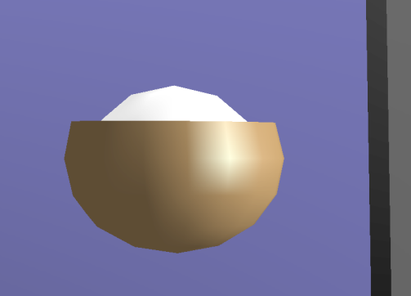
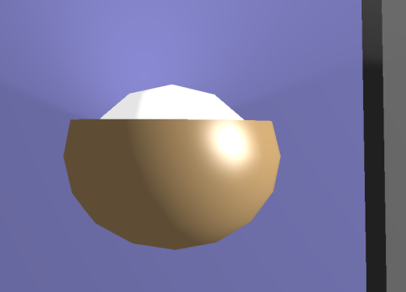
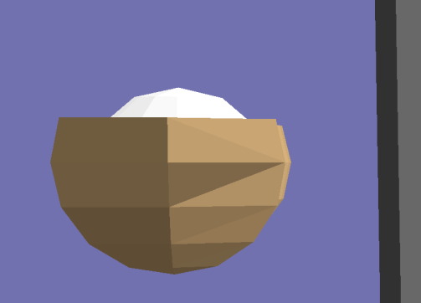
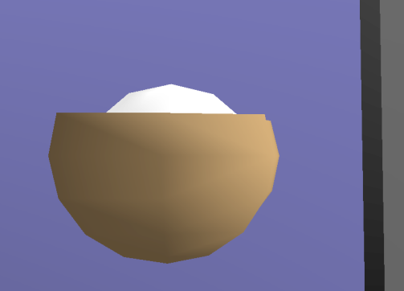
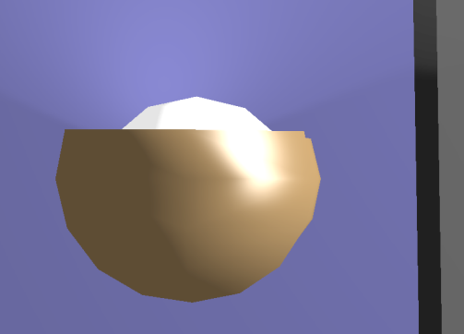
Comparison.
Flat
Gouraud
Phong
Coarser mesh
Lecture 6

Slide 21
Problems with interpolation shading.
Problems with computing vertex normals.
A,B are shared by all polygons, but C is not shared by the polygon on the left.
Shading information calculated to the right of C will be different from that to the left.
Shading discontinuity.
A
C
B
Solution : introduce a ‘ghost’ vertex that shares C’s values
Lecture 5

Slide 22
Problems with interpolation shading.
Problems with computing vertex normals.
Face surface normals and averaged vertex normals shown.
Unrepresentative so add small polygon strips along edges or test angle and threshold to defeat averaging.
Lecture 5

Slide 23
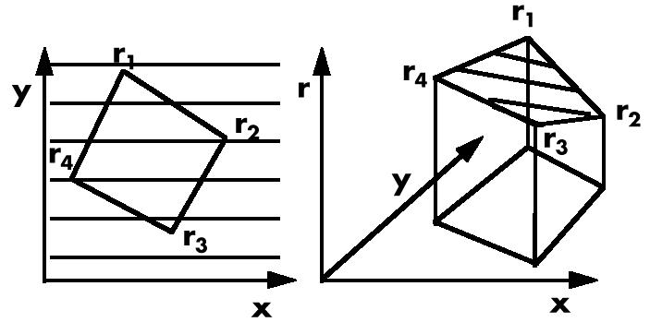
Problems with interpolation shading.
Perspective distortion.
  Perform interpolation after perspective transformation.
Must perform interpolation in image space.
Could split polygon into lots of small triangles and it would look okay either way.
Lecture 5

Slide 24
Problems with interpolation shading.
Rotational invariance?
  The results of interpolation shading can change with orientation of the polygon.
A
Point on left is interpolated between AD & AB ,
Point on right is interpolated between AB & BC
B
D
B
A
C
D
C
Lecture 5

Slide 25
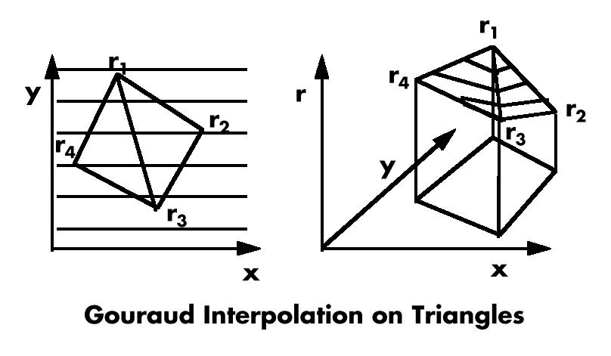
Problems with interpolation shading.
Solution.
  Decompose polygon into triangles before Gouraud shading.
Lecture 5

Slide 26
Summary of shading.
Constant shading
  approximation only holds for exceptional cases.
  appearance of Mach bands.
Gouraud shading – poorly interpolates specular highlights.
Phong shading – better, and better in animation too (less Mach banding).
Problems with interpolation shading.
Lecture 5

Slide 27
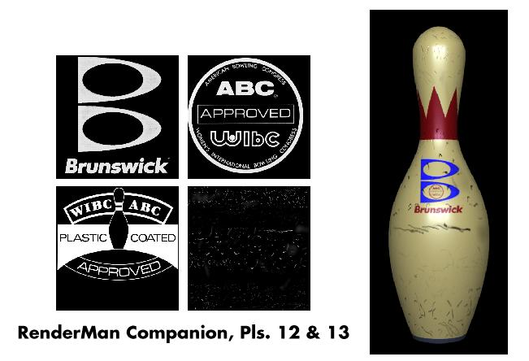
Texture mapping.
Method of improving surface appearance by adding details on surface.
Lecture 5

Slide 28
Texture mapping.
Image is ‘pasted’ onto a polygon.
Image is called a Texture map, it’s pixels are often referred as a Texels and have coordinates (u,v)
Texture coordinates are defined for each vertex and interpolated across the polygon.
y
v
v
u
u
x
Lecture 5

Slide 29
Texture mapping = 2D image warp.
2D texture Space
v
Parameterisation
3D Object space
u
Model Transformation
3D World space
Viewing Transformation
3D Camera space
Projection
y
2D Image Space
v
u
x
Lecture 5

Slide 30
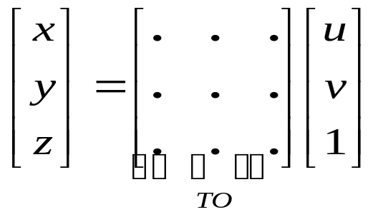
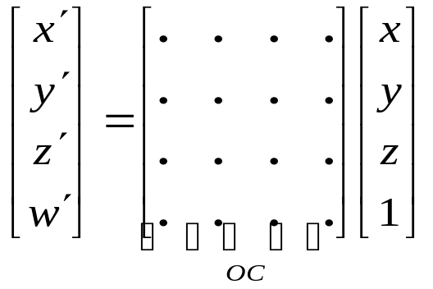
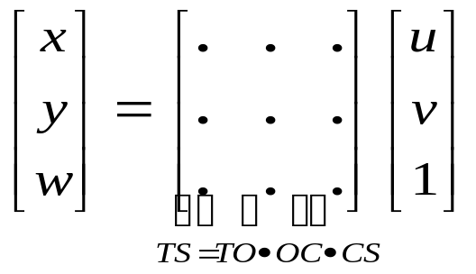
Polygonal Texture mapping.
Texture to Screen transformation composed of 3 transformations :
1. Parameterization may
be written as a linear
transformation from
texture space to object
Space (TO)
2. Modelling and viewing
transformation from
object space to camera
Space (OC)
3. Projection from camera
space to screen space (CS)
(not shown)
Lecture 5

Slide 31
Interpolation of texture coordinates.
Same problem as for Gouraud shading – need to break down into triangles for rotational invariance.
Linear interpolation leads to incorrect perspective.
Perspective interpolation
Linear interpolation
½ L
Lecture 5

Slide 32
Texture filtering.
Can map texture in 2 ways :
  From (u,v) space to (x,y) – forward mapping.
  From (x,y) back to (u,v) – reverse mapping.
Forward mapping is linear projective map.
Reverse mapping is inverse – also linear projective map.
  The inverse of a projective transformation is also a projective transformation.
Lecture 5

Slide 33
Texture filtering.
Pixel footprint changes from pixel to pixel
  No single filter.
Resampling theory : two cases
  Magnification – interpolate texel values.
  Minification – average texel values.
Texture
Image
Lecture 5

Slide 34
Texture filtering
Need to filter texels to avoid aliasing.
Useful filter shape is a weighted ellipse whose dimensions are controlled by the projective warp. – EWA filter.
Lecture 5

Slide 35
MIP map
Multum In Parvo = Many things in a small place
Sub-sample the texture, and store filtered samples in a pyramid.
When interpolating the texel value, use d parameter – texel : pixel ratio and tri-linearly interpolate.
- Efficient in storage as well.
d=4
d=2
d
v
u
d
u
v
Lecture 5

Slide 36
Texture mapping summary.
Paste a 2D image onto projected geometry.
Required transformation is a 2D image warp.
Need for projective interpolation.
Texture filtering.
  EWA
  Mip-map.
Lecture 5

Slide 37
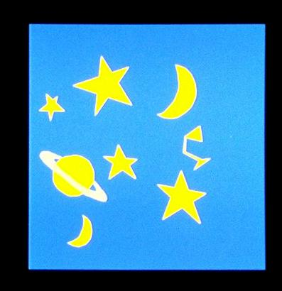
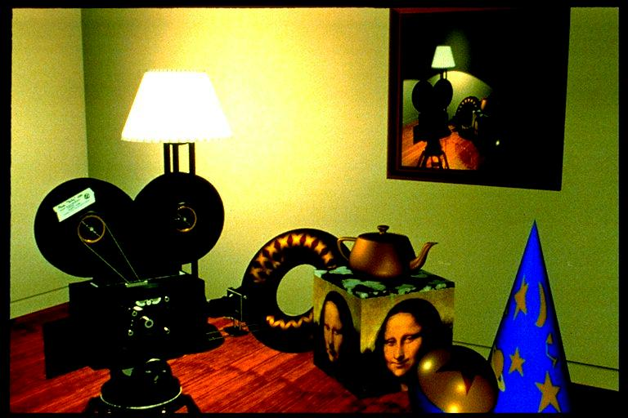
Texture mapping example
Lecture 5

Slide 38
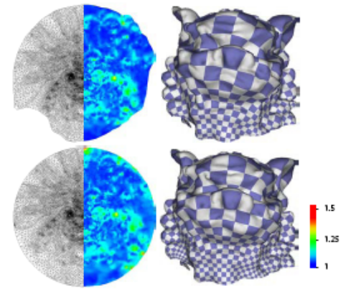
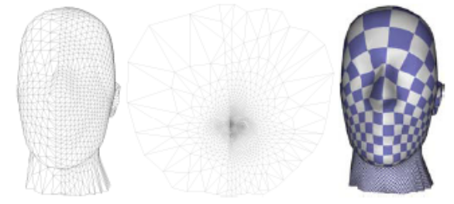
Parameterization and Texture Mapping
Discrete Differential Geometry: An Applied Introduction
Course note, ACM SIGGRAPH 2005
Lecture 5

